Slide 1
Predicting NF2 with neural crest data
Ankita Das, Don Andres, Akshay Maheshwari, Chaintanya Kulkarni, Calvin Legassick, Paul Kim

Slide 2
What are the regulatory and gene expression changes that occur in NF2 disease? Can we leverage these to find new drug targets?

Slide 3
What are the regulatory and gene expression changes that occur in NF2 disease? Can we leverage these to find new drug targets?
Almost no NF2 patient data publically available :-(

Slide 4
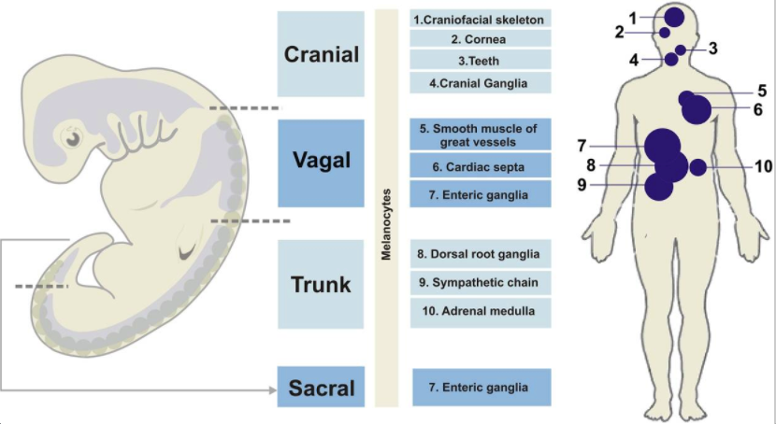
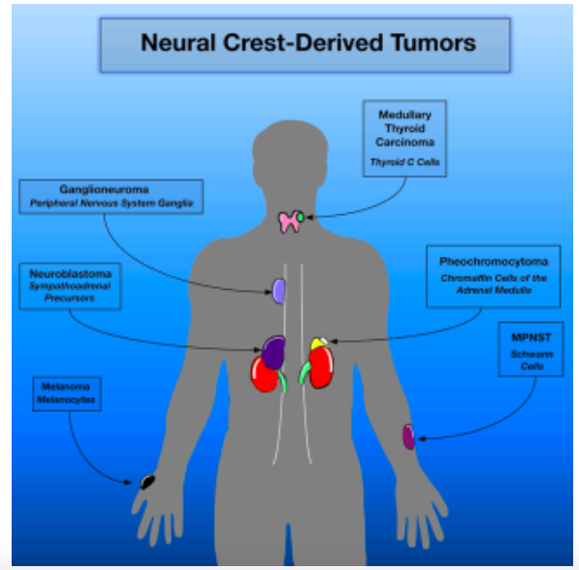
Neural crest: Cellular origin of NF2
Developing embryo
Normal adult neural
Crest tissues
Neural crest tumor

Slide 5
Our solution: Leverage related data
Compare transcriptomic data from:
Embryonic normal neural crest cells
Neural crest tumors/cancers
Other NF2 gene mutation tumors/cancers
Identify relationships in gene expression between the three classes
Predict outcomes & determine NF2 causing gene pathways/networks

Slide 6
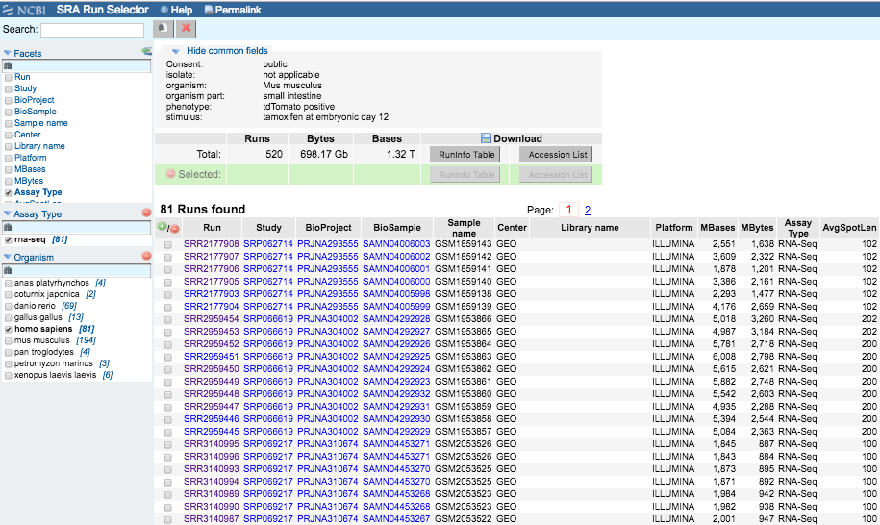

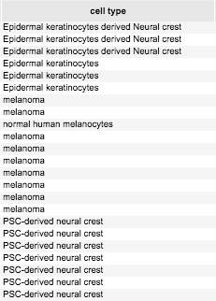
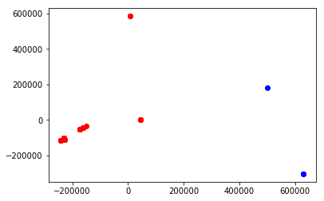
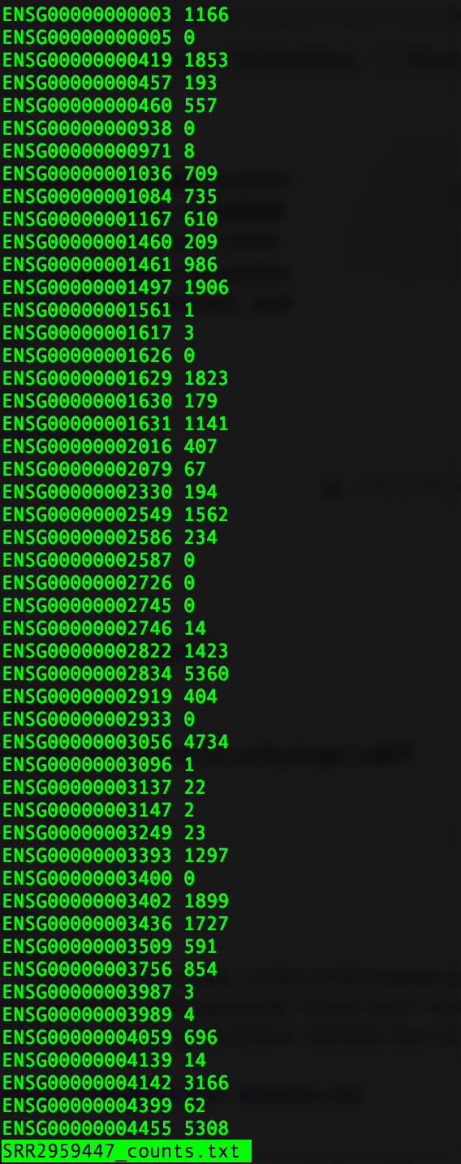
How it works
Identify genes whose expression differences most accounts for separation between classes ( normal vs tumor )
RNA-seq data from NCBI
Bioinformatics
Gene ontology of the top genes
To determine NF2 related pathways
ML algorithms to reduce dimensionality
Notes:
Melanoma, meningioma

Slide 7
Conclusion
Our team is an awesome blend of backgrounds:
1 biologist, 1 medical student, 1 bioinformatician, 2 computer scientists, 1 distributed systems expert,
This led to a highly optimized pipeline:
82 RNA-seq datasets in 12 hours (instead of 5 days)
NCBI/SRA datasets can be leveraged to understand rare disease mechanisms
ML can (should) be used to solve genomics problems
Next steps:
Analyze VCF files from Ono and his sibling to identify SNPs and correlate differences with our transcriptional data
Find candidate genetic pathways responsible for his NF2

